Slide 1

Onions
Jashon Newlun

Slide 2
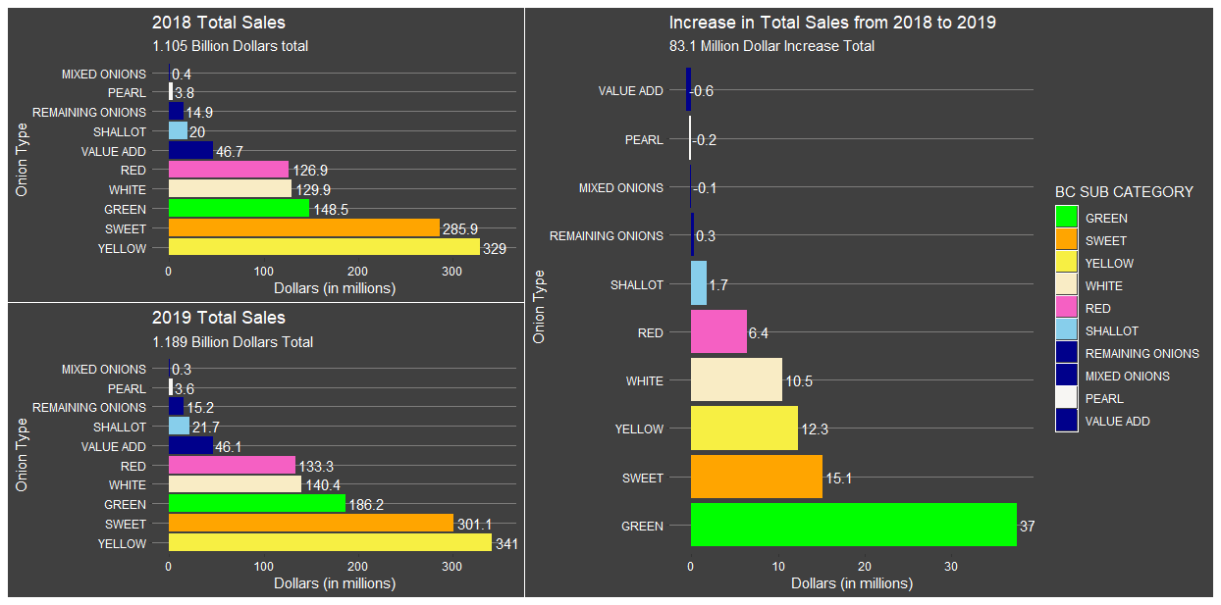
Year to Year Aggregate Sales
Green onions saw biggest increase, the significance of this increase is compounded because green trails sweet and yellow greatly in total sales.
8-9% increase in sales over one year.
Though individual comparisons with the dark blue aren’t overly helpful, they contribute largely to the aggregate.
Value Add and Mixed did experience some decrease, we hope that this was in part due to better classification.
Pearl also decreased slightly.
Yellow and Sweet lead in sales
Green, White, and Red seem to be in the next bin, similar sales.
Shallots and pearl onions are small percentages when compared with the whole.

Slide 3
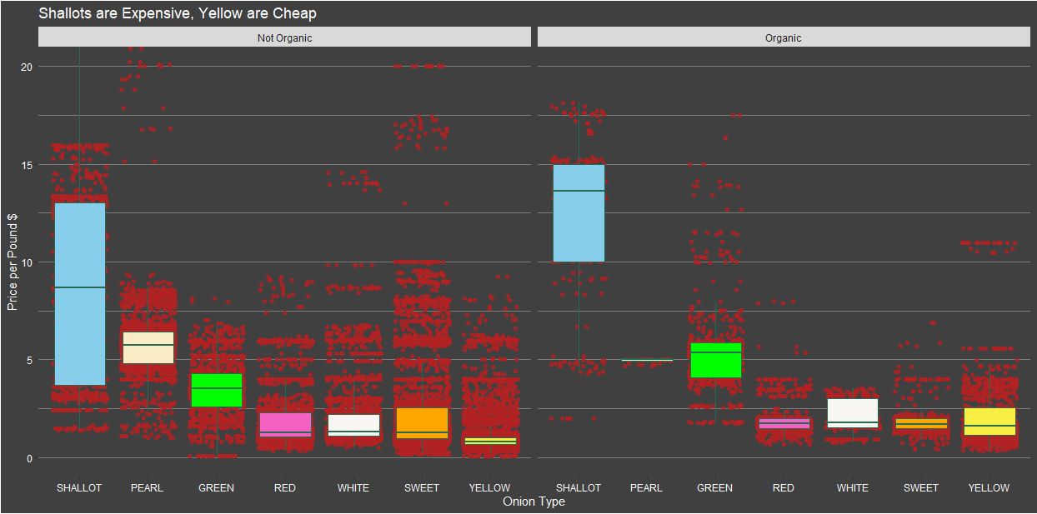
Price Per Pound
Shallots may seem to have a large spread, though this factor could be largely affected by location, time of year, and time of season. With more expensive veggies, it may be possible that sales happen more often to incentivize purchases of complimentary veggies.
Many of the onions have a huge right skew. This attribute must also be affected by location, time of year, and time of season. Organics seems to skew right less often.
The price per pound of an onion type seems to be related to what type of skew it will have. I.E the higher the average price per pound the greater probability of a left skew.
Not only do Shallots cost the most, on average, they also by far have the largest spread. Organic still have a large skew, but an overall smaller spread.
When the average consumer imagines onions. They typically think of those four cheapest. Yellow are cheaper on average than the other four, but not by much.
Organics are usually more expensive.

Slide 4
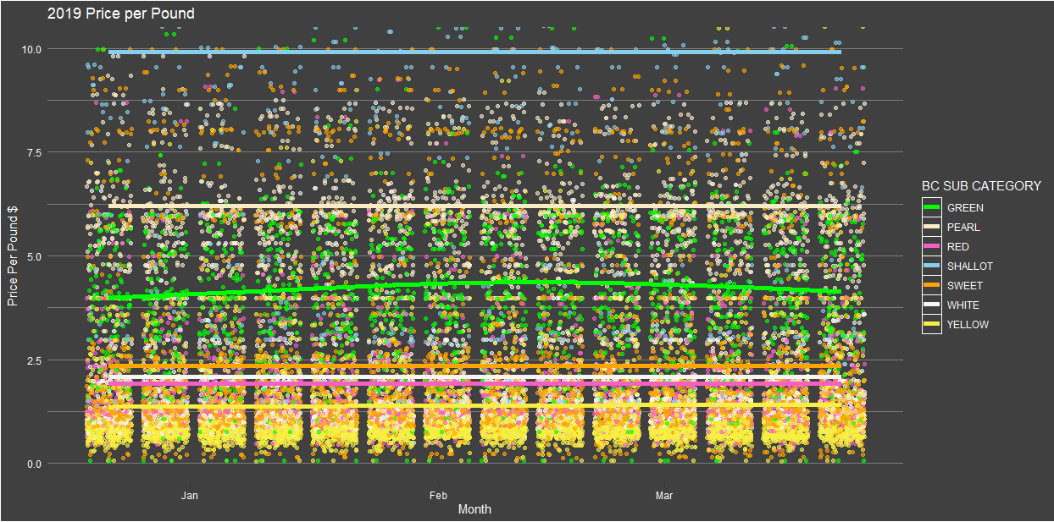
Though most prices are constant, green onions did see some change over the three months, leveling out where it began.
Though the “over-time” metric doesn’t show much in terms of change, it is useful as an overall comparison. Many onions, though seemingly constant, have wide variation in their prices and spread. The overall spread of onion sales is significant, because there is a steady decrease in the density of points as the price per pound increases.

